Slide 1
STEAM BOILER EFFICIENCY USING BIOMASS
Dr Terry Dixon
COGENERATION WORKSHOP
XXI Congreso De Tecnicos Azucareros
De Centroamerica
21 - 25 August 2017

Slide 2
DIXON SOLUTIONS Pty Ltd Dr Terry Dixon

Slide 3
TOPICS TO BE COVERED
Boilers and Efficiency in the Cogeneration context
Three pillars of Cogen – Factory Steam Demand, Bagasse Moisture, Boiler Efficiency
Australian cogeneration context
Efficiency components
Fixed and Variable factors
Design parameters
Operational factors
Maintenance factors
Monitoring and Management

Slide 4
BOILERS, EFFICIENCY and COGENERATION
Cogeneration is all about energy management
Fixed (and free) fuel supply – bagasse, cane trash
Limited auxiliary fuels (coal, other biomass)
Electric Power only viable by-product of bagasse
Very limited Pulp-Paper usage
Cogeneration technology not “advanced” compared to pf coal-fired boilers and turbines
Several boiler and turbine design combinations, but relatively “standard”
Management mindset needs to change to fully utilise cogeneration potential

Slide 5
THREE COGENERATION PILLARS
All about bagasse supply and usage
Bagasse Production – Moisture Content
Milling tandem settings and optimisation – produce the lowest possible bagasse moisture
Factory Steam Demand – “Steam-On-Cane”
Complex economic equation to support reduced SOC
Boiler Efficiency – some controllable factors
Recovery of Cane Trash is 4th Pillar

Slide 6
AUSTRALIAN COGENERATION CONTEXT
Australia has huge coal reserves (8.6% - USA 26.6%, Russia 17.6%, China 12.8%)
Export Power return not economically viable
Large Boilers – 150 tph to 320 tph; Low Pressure
High Factory steam demand (SOC > 48%)
Must incinerate all bagasse
“Waste Energy Very Efficiently”
Several boiler efficiency reduction techniques
Excess Air
Spray Water on Bagasse
Partial Bypass Economiser / Airheater
Hot Gas Bypass
Dump Steam Condenser

Slide 7
EFFICIENCY – THE ENERGY BOX
Consider the Energy Envelope
Inputs to Energy Box
- Ambient Air
- Wet Bagasse from Mill / Storage
- Feedwater to Economiser / Drum
Outputs from Energy Box
- Final Flue Gas (Oxygen, Temperature)
- Moisture as steam
- Steam to turbines
- Carbon Monoxide
- Unburnt Carbon
- Minor Losses (hot ash, radiation)

Slide 8
BOILER CROSS-SECTION

Slide 9
La Grecia – Caldera #3

Slide 10
ENERGY BOX
ONLY factors are the Inputs and Outputs
Whatever happens inside the Energy Box does not alter the calculation of the Efficiency
Various design techniques to recover energy and increase energy efficiency
- Air – Airheaters
- Water – Economisers
- Bagasse – Bagasse Dryers
Whatever occurs – final flue gas temperature after last Airheater / Economiser is the key parameter

Slide 11
BOILER EFFICIENCY
Direct Method
- Measure Steam Flow + Steam Press & Temp and Feedwater Press & Temp
- Measure Bagasse Flow
- Organised Correct Bagasse Samples
- Moisture, Ash, GCV
Losses Method
- Organised Correct Bagasse Samples
- Organised Correct Ash, Fly Ash Samples
- Boiler Temperatures (air, flue gas)
- Organised Correct Flue Gas Composition
- Oxygen, Carbon Monoxide

Slide 12
BOILER EFFICIENCY COMPONENTS
Energy Loss components same for ALL Boilers (Bagasse, Coal, Palm Fibre etc.)
Decreasing Order of Importance
- Bagasse Moisture
- Combustion Moisture (H₂ in bagasse)
- Flue Gas (Temperature, Excess Air)
- Unburnt Carbon (Carbon in Fly Ash)
- Carbon Monoxide
- Radiation / Convection from surfaces
- Hot Grate Ash and Dust Collector Ash
- Moisture in Air

Slide 13
EFFICIENCY LOSS COMPONENTS
Typical Values
- Bagasse Moisture 13.5%
- Combustion Moisture (H₂) 8.2%
- Flue Gas 5.2%
- Unburnt Carbon (CIA/UBC) 1.9%
- Carbon Monoxide 0.20%
- Radiation / Convection 0.40%
- Hot Ash – Dust 0.15%
- Moisture in Air 0.16%
Examine variations

Slide 14
EFFICIENCY LOSS VARIATIONS
120 tph Boiler – Base Conditions
- Ambient 30ºC
- Bagasse Ash (% dry) 4.0%
- Bagasse Moisture 50%
- Bagasse Pol 1.8%
- Ash Split (Grate/Scrubber) 20 / 80
- Unburnt Carbon (UBC) 15% - 30%
- Carbon Monoxide 200 ppm
- Oxygen / Excess Air 4% - 35%
- Flue Gas Temperature 160ºC
Boiler Efficiency 68.20%

Slide 15
EFFICIENCY LOSS VARIATIONS
Typical Variations – 120 tph Boiler
Bagasse Moisture 47.5 – 52 69.58 – 66.99 2.59%
Combustion Moisture (H₂) Nil
Temperature 180º – 130º 67.0 – 70.0 3.00%
Oxygen 3.2% - 5.5% 68.54 – 67.46 1.08%
Carbon Monoxide 500 – 2000ppm 68.09 – 67.54 0.55%
Unburnt Carbon (CIA) 5 – 50% 70.22 – 65.13 5.09%
- Radiation / Convection 0.40%
- Hot Ash – Dust 0.15%
- Moisture in Air 0.16%
1% Efficiency gain – save 0.7 tph bagasse – 17 tpd

Slide 16
FIXED and VARIABLE LOSSES
- Bagasse Moisture YES
- Combustion Moisture (H₂ in bagasse) FIXED
- Flue Gas Temperature DESIGN
- Flue Gas Excess Air YES
- Unburnt Carbon DESIGN + OPERATION
- Carbon Monoxide DESIGN + OPERATION
- Radiation / Convection from surfaces
- Hot Grate Ash and Dust Collector Ash
- Moisture in Air

Slide 17
CARBON MONOXIDE ANALYSER
CO can be a major efficiency loss
Personal view – CO monitoring is not necessary to achieve maximum boiler efficiency
- Boiler Oxygen – Carbon Monoxide characteristic curve is unique for a boiler
- O2 – CO curve tells accurately what the status of CO emissions would be
- CO characteristic is very “spikey” and highly non-uniform – difficult to operate a control loop
- Complex analyser to calibrate and maintain.

Slide 18
CO CHARACTERISTIC - FUELS

Slide 19
CO - NORMAL

Slide 20
CO - OSCILLATIONS

Slide 21
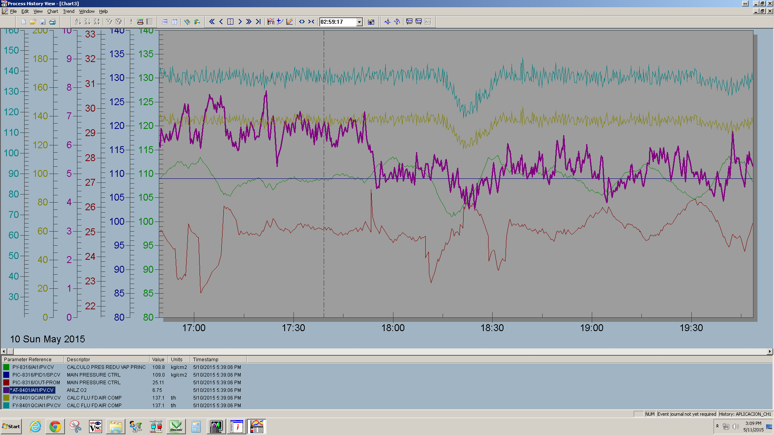
COGEN BOILER A

Slide 22
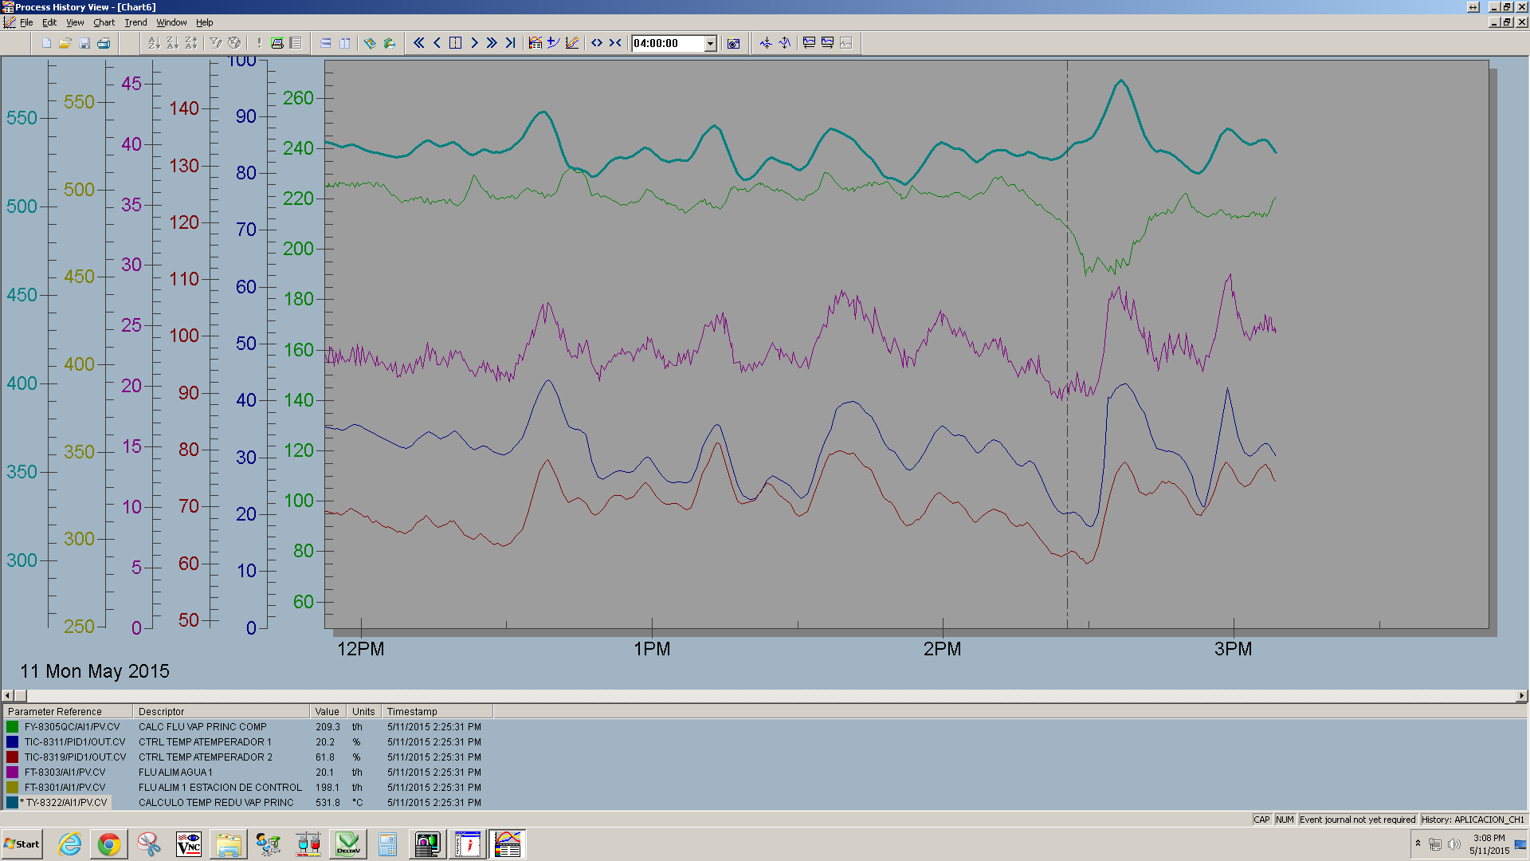
COGEN BOILER A

Slide 23
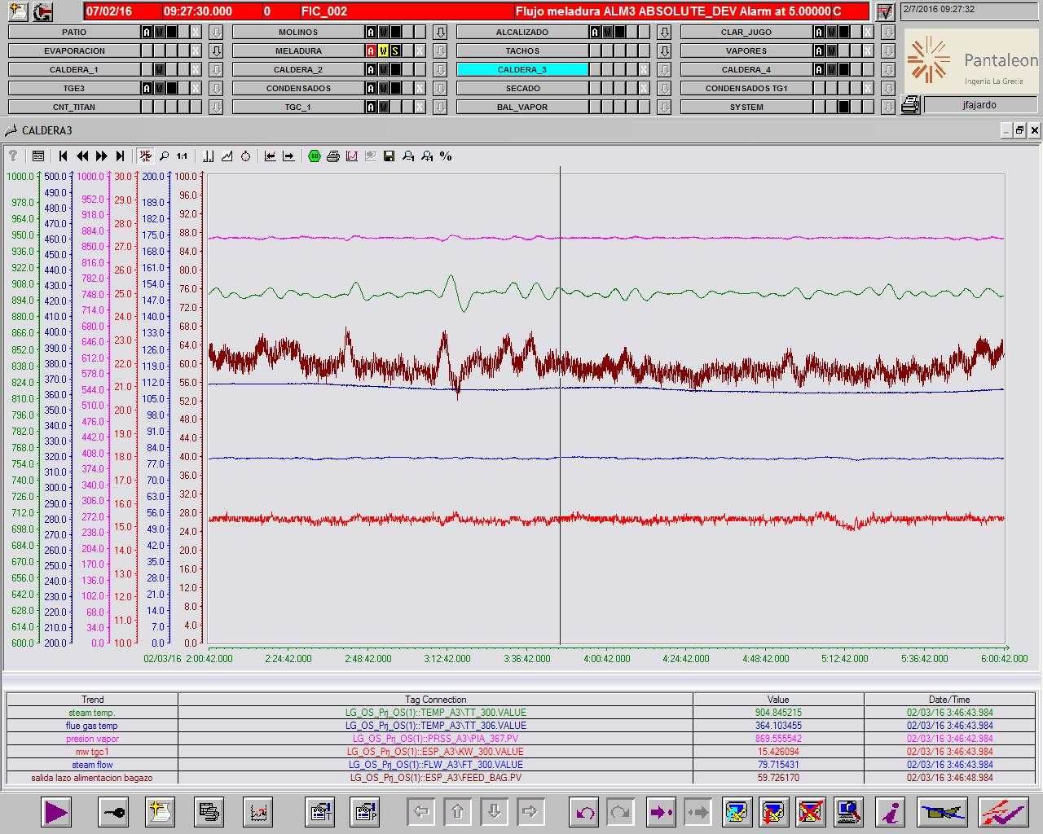
COGEN BOILER B

Slide 24
BOILER DESIGN PARAMETERS
Furnace design for multiple factors
- Combustion
- Char Burnout
- Ash fouling
- Evaporation / Superheat
Convection Bank – evaporation; structural
Economiser and Airheater
- energy recovery
- overall boiler efficiency
Bagasse Dryer … ?
Air and Gas flows – ID, FD and SA Fans

Slide 25
OPERATIONAL FACTORS
Bagasse Moisture Content governs everything
Therefore – good Milling Tandem operations are fundamental !!!
Very little boiler controls can do to minimise impacts of wet bagasse
Bagasse System – bypass wet bagasse around boilers ???
Combustion is key to stable steam generation, low grate deposition and high efficiency
Bagasse Spreaders / Distributors set correctly

Slide 26
BAGASSE SPREADERS
Like Carburettor on your car engine .…
“If the Carburettor is not tuned correctly, the whole car engine does not perform well !”
Key to good bagasse combustion is full suspension burning
- bagasse dispersed and distributed well in suspension
- good mixing with hot furnace gases and Undergrate Air
- maximum drying, ignition and burning
- only largest particles fall onto grate
Constant spreader air pressure

Slide 27
SECONDARY AIR SYSTEM
Many designs of Secondary Air systems
Many designs are not optimum
Performance requirements
- control bagasse deposition at rear of grate
- additional Oxygen injection to burn-off char and Carbon Monoxide (mixing)
- manipulate furnace up-flow to provide optimum gas flow trajectory around nose and through Superheater banks
Split of FD air (Undergrate) and Secondary Air
- impacts on lower Furnace geometry

Slide 28
OPERATIONAL FACTORS
Efficiency focus – not safety (Drum Level)
Tuning of major control loops
- Master Pressure (Bagasse Feeders)
- Steam Temperature (Attemperators)
- Oxygen Trim (FD flow)
- Furnace Pressure (ID Fans)
- Possible Secondary Air modulation (?)
Objective is minimum deviations from Set Point and minimise major excursions during upset conditions
Control deviations from set point are small, so efficiency losses are small BUT these accumulate over a long time

Slide 29
OPERATIONAL FACTORS
With DCS – no valid reasons why cogeneration boiler operations cannot be fully automated – no Operator “fiddling” for normal operations, including mill stops and starts !
Disturbance conditions can be controlled
Exception is physical plant limitations
Power Grid trip condition
- technically possible and achievable to have factory TA sets “islanding” when disconnected from grid
- maintain full factory operations at reduced boiler steam flows

Slide 30
OPERATIONAL FACTORS
Options for short term cogen operations dictated by Power Purchase Agreement (PPA)
Peaking demand and increased sell price ?
Economics driver – modify crushing operations to maximise power export
Australia – stop crushing during periods of high export power prices …..
Boiler operations are key to maximising bagasse surplus for cogeneration
Process operations and Mill Tandem operations are fixed over short term
Strong Management directives and focus

Slide 31
OPERATIONAL FACTORS
Record and store records of operating data and all plant analyses
Historical record of plant performance parameters is valuable tool for problem solving and asset management

Slide 32
MAINTENANCE FACTORS - SPREADERS
Spreader Plates set at correct angle
(~3º UP above horizontal)
Spreader plates flat and smooth –
no distortion
Spreader air nozzles straight, uniform,
correct size
Wing Spreaders have deflector guides
Air pressures set to specification
Optimum duct geometry upstream of spreaders

Slide 33
MAINTENANCE FACTORS - INSTRUMENTATION
Checks and calibration of main instrumentation – temperatures, pressures through gas passes to ID Fans
Gas Temperatures are fundamental
Calibration of Oxygen analyser is critical
Boiler can be operated well just by understanding and following what the Oxygen analyser tells you

Slide 34
MAINTENANCE FACTORS - OTHER
Bagasse Feeders – uniform discharge
Airflow distribution in Undergrate Plenum (optimum combustion)
Economiser tube erosion (availability)
Airheater tube corrosion (increased FD and ID fan power consumption)
Convection Bank tube erosion (availability)
ESP Performance (statutory limits)
Air / Gas flow distributions and ash particle trajectories are key to resolving these issues

Slide 35
MONITORING and MANAGEMENT
Problem is magnitude of efficiency improvements
0.7 tph – 17 tpd Bagasse Saving does not look or sound large
Many hours and days of improvement add up to many tonnes of bagasse for cogeneration
Challenge for Supervision and Management
Fundamental is continuity of attention
Operators respond positively when they know management is interested in how they operate the cogen plant

Slide 36
MONITORING SYSTEM
Regular representative samples of ash from AH, EC and Scrubber / ESP dust hoppers (2 per week) – sampling accuracy important
Reliable Analysis for UBC (procedure)
Regular representative sampling for Oxygen and Carbon Monoxide (correct sample location) – check In-Situ Oxygen Analyser
Reporting results to all relevant people, including Boiler Operators
Supervisors regular review and discussion of results with Operators

Slide 37
MANAGEMENT
Conscious examination and understanding of summary reports
Frequent superficial contact with supervisors and operators to discuss operating status and progress
Management awareness increases the perceived importance of boiler efficiency in cogeneration operations
Because the short-term efficiency improvements are small, easy to overlook and forget – bagasse is lost !
Lost opportunities for increased business returns

Slide 38
BOILER EFFICIENCY SUMMARY
Cogeneration Totally driven by economics – Power Purchase Agreements (PPA’s)
Can be large income stream for business
Technical complexity of cogeneration plant and boiler are not high
Operating complexity of cogeneration plant and boiler are not high
Save bagasse – more power export
Because efficiency improvements are small, focus is lost
Needs strong Management attention and focus

Slide 39
THANK YOU
QUESTIONS ?

Slide 40
BIOGRAPHICAL
Terry Dixon has been working in the boiler and combustion fields for over 40 years. He started after graduation in the electric power industry, then spent over 20 years in the sugar industry in Australia with Sugar Research Institute (SRI). His final position was as Engineering Manager. Dr Dixon’s research and development interests included all aspects of boiler technology, combustion dynamics, bagasse drying, bagasse gasification, cogeneration and energy dynamics in the sugar process. He consulted widely to numerous world sugar industries. He subsequently moved to the electric power industry where he specialized in boiler design, coal combustion dynamics, coal milling, slagging dynamics, energy efficiency and maintenance management. Dr Dixon is currently the Director of Dixon Solutions Pty Ltd and consults widely in the sugar and electric power industries worldwide.

Slide 41
BP WORLD COAL RESERVES
Country | Anthracite & Bituminous (mt) | Sub-bituminous & Lignite (mt) | Total | Share of Total | R/P ratio
US | 108501 | 128794 | 237295 | 26.6% | 292
Russian Federation | 49088 | 107922 | 157010 | 17.6% | 422
China | 62200 | 52300 | 114500 | 12.8% | 31
Australia | 37100 | 39300 | 76400 | 8.6% | 158
India | 56100 | 4500 | 60600 | 6.8% | 89
Germany | 48 | 40500 | 40548 | 4.5% | 220
Ukraine | 15351 | 18522 | 33873 | 3.8% | *
Kazakhstan | 21500 | 12100 | 33600 | 3.8% | 316
South Africa | 30156 | - | 30156 | 3.4% | 120
Indonesia | - | 28017 | 28017 | 3.1% | 71
Serbia | 1 | 13410 | 13411 | 1.5% | 352
Turkey | 322 | 8380 | 8702 | 1.0% | 192
Other Europe & Eurasia | 1388 | 5494 | 6882 | 0.8% | 187
Colombia | 6746 | - | 6746 | 0.8% | 79
Brazil | - | 6630 | 6630 | 0.7% | *
Canada | 3474 | 3108 | 6582 | 0.7% | 108
Poland | 4178 | 1287 | 5465 | 0.6% | 40

